Slide 1
Fall 2020
Studio Information Session
ECSE 2610
Computer Components and Operations (CoCO)

Slide 2
Agenda
Instructor introduction
Equipment required for studio exercises
Online tools we will use for the class
Software we will use for the studio exercises
Q and A

Slide 3

CoCO Instructor
Dr. Mahmood A. Hameed
  Email: hameem2@rpi.edu
  WebEx: https://rensselaer.webex.com/meet/hameem2
  Other courses: ECSE 1010, 2410, 2660, 4520, 4560/6560, 4900
  ENGR 2300

Slide 4
Who is enrolled in this class?
Current numbers
  Freshman 4
  Sophomore 86
  Junior 16
  Senior 6
Split into three sections
  Different studio times

Slide 5
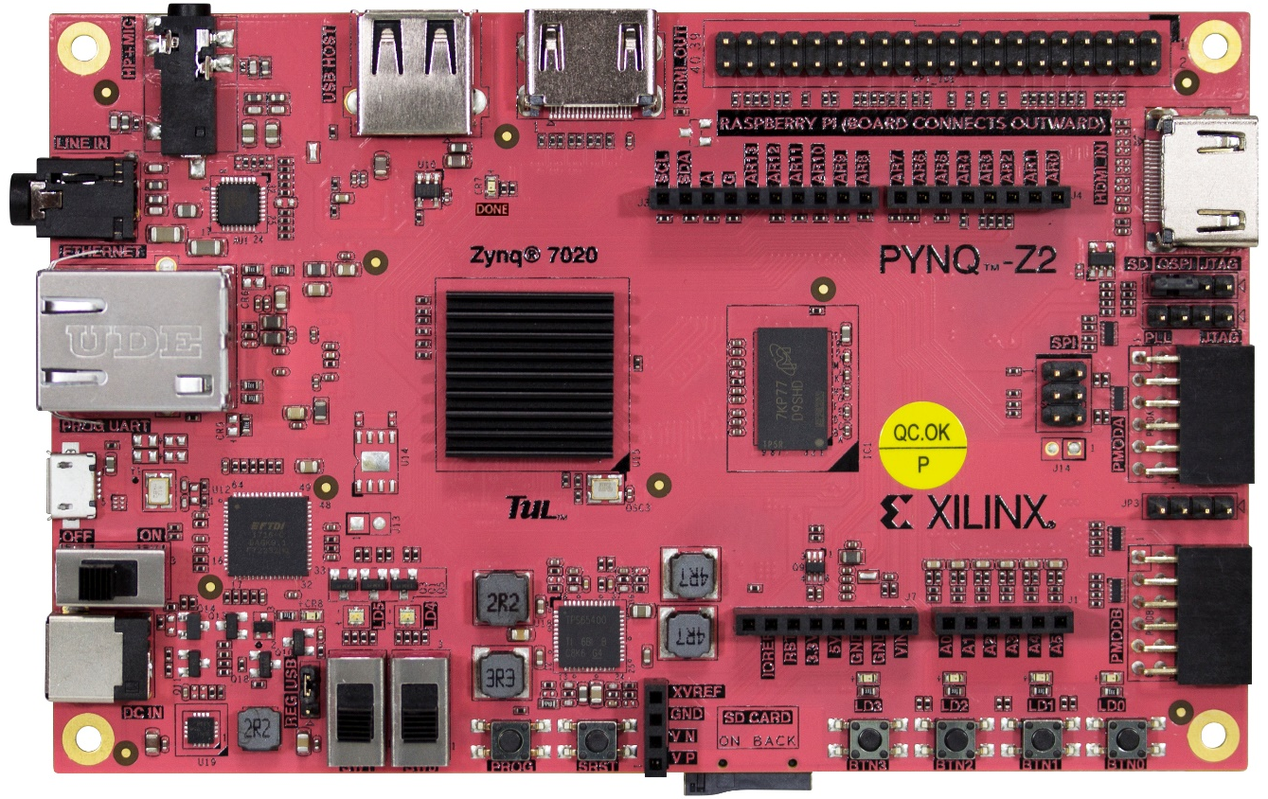
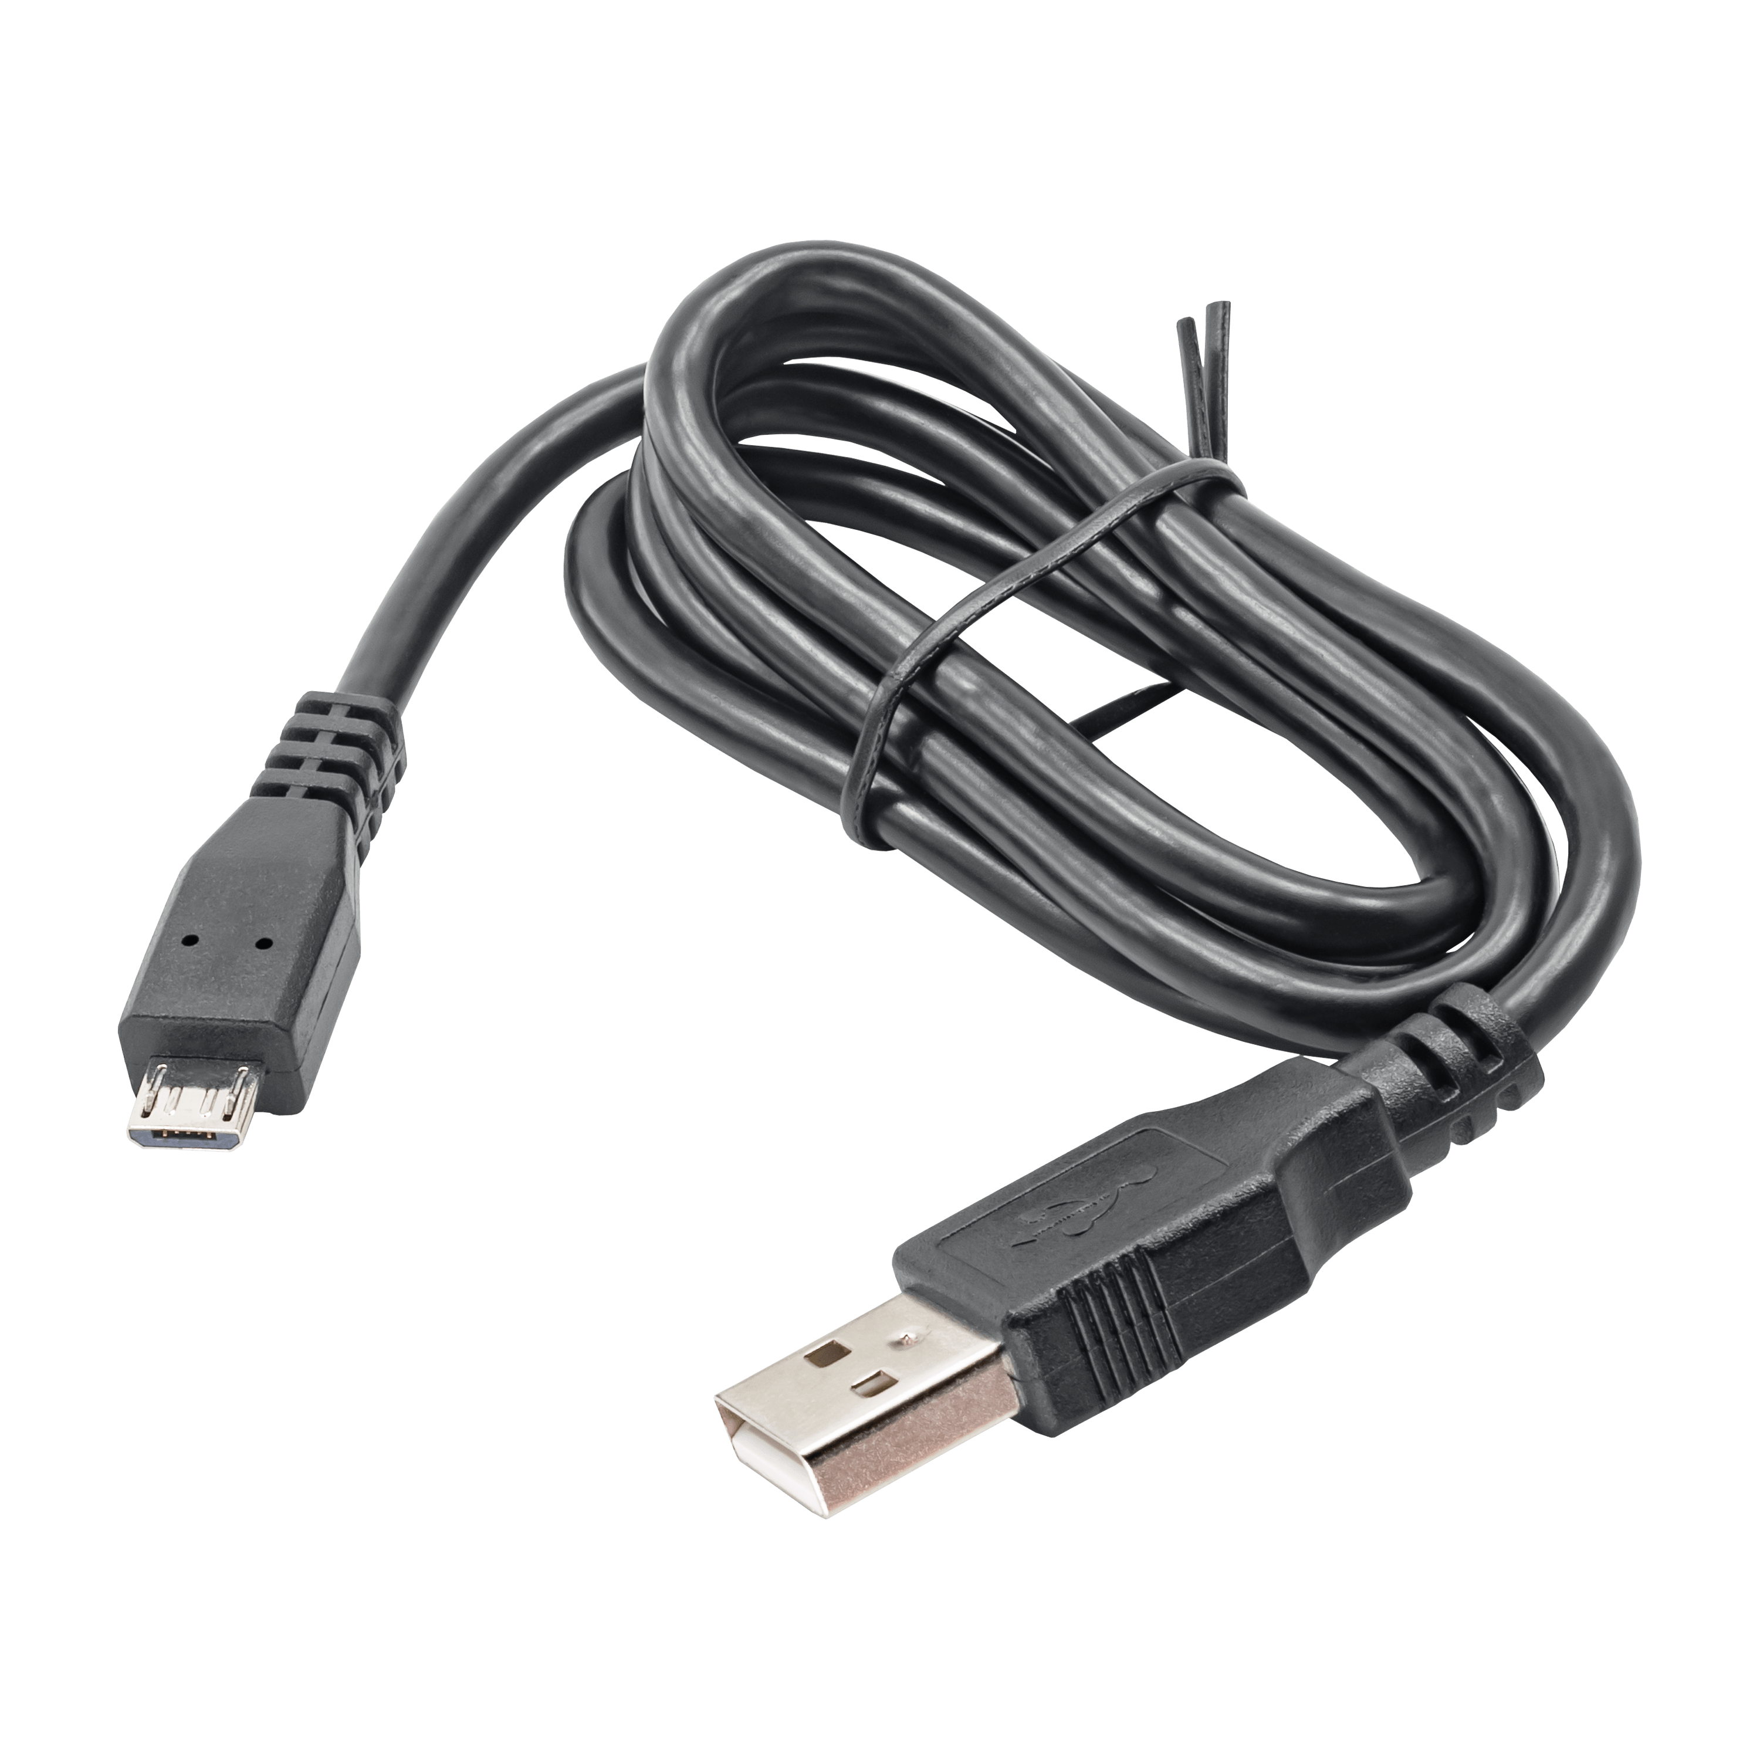
Required Studio Equipment
PYNQ-Z2 board
Add-on Board
USB-A to micro-B cable

Slide 6
When should I purchase the equipment?
Roster will be sent to TUL during first week of August
  To get reduced pricing ($90.00 for Pynq-z2 and $10.00 for add-on)
  Plus shipping
Expect an email from me during the first week of August
  Detailed instructions
  Links to purchase
  Information you’d need to include in your order

Slide 7
Where is my studio?
Fully remote studio on WebEx (during studio time)
  Exercises will be available a few days before the actual studio
    Recommend you to start working on them early
  Alternate remote studio times (later in the day) will be offered
    Accommodate various times zones
Studio check-off process (during studio time)
  Use camera and microphone to demonstrate work to the TA
  TAs will ask some questions during check-off process

Slide 8
Where is the Lecture?
On WebEx meetings (TF 10:30 to 11:50 am eastern)
  Same time for all three sections
  Will be recorded
Get a head start?
  Lectures from summer 2020 are online
  YouTube, Mahmood Hameed, RPI ECSE 2610 playlist
  https://www.youtube.com/playlist?list=PLlutgI5N-PzuC962m3oLNffV1ogGdK6Gw

Slide 9
Online tools
Piazza: discussion forum, Q & A
Gradescope: all class related submissions and grading
YouTube: recorded lectures
WebEX meetings: Live lectures, exams, office hours

Slide 10
Software for the studios
Xilinx Vivado Design Suite: for FPGA related exercises
  Vivado Design Suite - HLx Editions - 2019.2
  WebPack edition
LogicWorks 5: for design exercises using 7400 series ICs

Slide 11
Q & A

Slide 12
Grade Composition (May change a bit)
Homework 10% (~weekly)
Studio exercises 20% (~weekly)
Midterm Exam I 20% (1/semester)
Midterm Exam II 20% (1/semester)
Final Exam 30% (1/semester)

