Slide 1
Reader’s Guide to Pattern Recognition & Machine Learning
George Nagy
Professor Emeritus, RPI
I am obliged for this material to current and former colleagues
and students, and the web. Only the mistakes are strictly my own.
Notes:
Thank you for inviting me!
I guess I am qualified for this talk because I own more than100 books with PR or ML in the title. Disclosure: I have not read the all.

Slide 2
Definitions
Pattern recognition is the study of
how machines can observe the environment, learn to distinguish patterns of interest from their background
and make sound and reasonable decisions about the categories of the patterns.
- Anil K. Jain
Machine Learning is the field of study that gives computers the ability to learn without being explicitly programmed.
- Arthur Samuel
Notes:
Anil Jain is a leading theoretician and practitioner of pattern recognition and biometrics.
Arthur Samuel’s checker-playing program beat the fourth-best US player in 1962.
(Jain’s definition in PAMI Review of Statistical Pattern Recognition 2000).
Samuel’s is from 1959, re checkers.)

Slide 3
Some related disciplines with their own dialects
Multivariate, discriminant and regression analysis
Hypothesis testing, confidence intervals
Statistical decision theory
Information retrieval
Target detection
Biometrics verification / iden’n
Computational biology
Data mining
Information extraction
Signal processing
Mathematical taxonomy
Modern/optimal control
(Artificial) neural networks
Genetic & evolutionary algorithms
Notes:
Many of the ideas I will discuss are shared or were originated by other fields.
Statistics is pervasive. In statistics TRAINING and LEARNING are called PARAMETER ESTIMATION. The other related fields are listed roughly by age.

Slide 4
Table of Contents
Pattern Recognition vs. Machine Learning
Classification
Neural Networks & Deep Learning
Performance Evaluation
Partially supervised classification
Historical notes on NN & PR
Notes:
I was asked to try to clarify the distinction between pattern recognition and Machine learning, so I made a few slides

Slide 5
Machine Learning vs. Pattern Recognition
emphasis on learning emphasis on classification
middle-aged (b. 1959) elderly (b. ~ 1935)
computer scientists engineers
ACM IEEE
J. Machine Learning Research PAMI (IEEE Trans Pattern Analysis and Machine Intelligence
≅
PAC
NN
PAC
NN
Notes:
In ML, there is more emphasis on learning, in PR on classification.
Some folks consider most of pattern recognition as part of machine learning.
Others have the converse view.
For example ML may exclude Nearest-Neighbor classifiers, and
PR excludes Probably Approximately Correct (PAC) learning.
But they have far more in common than different and they are converging rather than diverging.

Slide 6
Terminology
ML PR
learner trainable classifier
instance sample or pattern
representation feature
concept learning classifier design
concept, target concept/function decision rule/function
positive and negative examples no asymmetry
hypothesis space parametrized family of decision functions
naïve Bayes Bayesian classifier with independence assumption
Occam’s Razor Minimum Description Length (MDL)
active learning active sampling
inductive learning optimize on training samples
deductive learning domain-specific constraints
probably approximately correct (PAC ) why bother?
VC dimension
Notes:
Here is a small dictionary. My accent is a Pattern Recognition accent because I learned it first.
Some words introduced by Machine Learning adepts are:
learner, concept, hypothesis-space, naïve Bayes, inductive learning, PAC, VC-dimension

Slide 7
Weasel Words mean exactly what you want them to mean:
Concept Data
Model Information
Semantics Knowledge
Context Interpretation
Ontology Understanding
as in:
“We situate our semantic concept models in an ontological context.”
Notes:
Some words are dangerously adaptable. For example, only you know exactly what you mean when you say ” “.

Slide 8
TOC
samples
sensor
PR & ML
Classification
Neural Networks & Deep Learning
Performance Evaluation
Partially supervised classification
Historical notes on NN & PR
feature
generation
feature
selection
classifier
design
system
evaluation
Notes:
The first three items in the flowchart are domain specific, so I will talk mainly about the last two.
I don’t expect to get to unsupervised adaptive systems and to historical notes, but hope to get to Performance Evaluation.

Slide 9
Data flow
Samples of raw observations from key entry or sensors
Unique ID assigned to each sample for replicability
Ground Truth labels for class and source from experts
Curation sometimes eliminates anomalous samples
Preprocessing cleans up data before feature extraction ??
Domain-specific feature design
Generic classifier assigns a classifier label to each sample
Experimental classification systems are evaluated by comparing classifier-assigned labels with GT labels
Notes:
The inputs to a classification system consist of labeled raw observations and design parameters.
Labels are usually categorical variables like a digit, a word, tiger, or pneumonia
I don’t like the Ground Truth, but don’t have anything better to distinguish it from classifier labels.
If Curation includes deleting or relabeling samples that you think your system cannot handle, then it it should be called fudging.
The output is a classifier label added for each sample.

Slide 10
Prep
Cost and accuracy of alternatives
Observations (categorical, image, time-series, sequence)
Data sampling
Spatial sampling, amplitude quantization
# classes: one (S/N), two, fifty, partition, fuzzy, hierarchy
Cost of misclassification and of rejects
Prior class probabilities
Class and source labels, label accuracy
Feature design categorical, binary, discrete, string, graph
Class-conditional feature distribution (dependences ?? )
Prior class-conditional feature probability distributions
Available software, programming & hardware resources
Notes:
Here are the tasks necessary before experimentation
Easily neglected topics in red.
For example, data sampling is too often done carelessly.
It is easiest to collect only a convenience sample of the most accessible, or most recent or most familiar records, instead of a representative sample from all available sources.
The cost of misclassification and that of no classification, and the various prior probabilities, may be hard to find out.
Source labels are important. Batching same source data can greatly improve accuracy, even if the source of each batch is not identified explicitly.

Slide 11
Some Classifiers (2 classes, 2 features)
Feature y
LINEAR BAYES
with pooled covariance matrix
QUADRATIC
MULTILAYER NEURAL NETWORK
SIMPLE PERCEPTRON
SUPPORT VECTOR MACHINE
NEAREST NEIGHBOR
Feature x
Notes:
Think of samples represented by feature vectors in a 20 or 200 or 2000-dimensional vector space.
But I illustrate everything in 2-D. A linear boundary in N dimensions, or hyperplane, is just a line in two dimensions. The feature space is usually smooth and sparse, so
patterns near each other are mostly similar, and most of the space is empty.
As we will see, on the same training data these classifiers will yield different decision boundaries and different error rates.

Slide 12
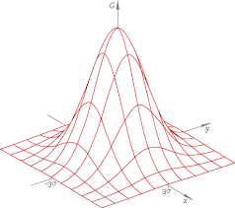
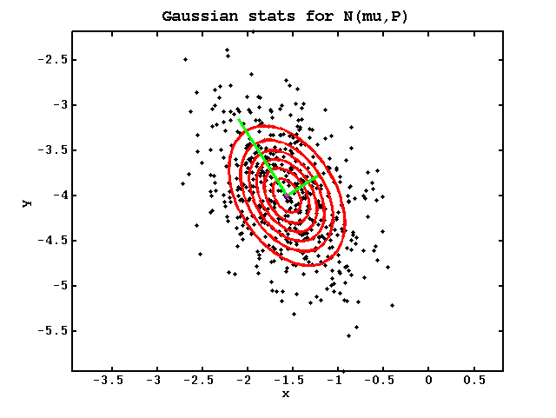
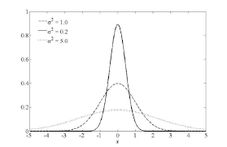
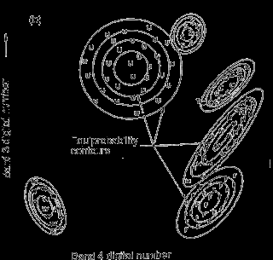
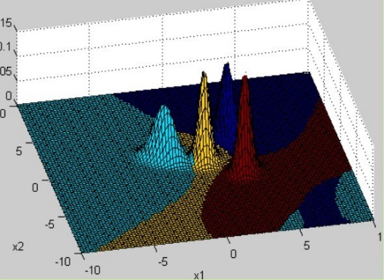
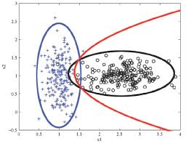
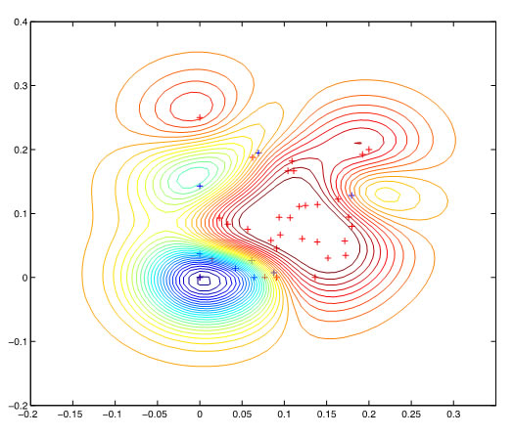
Gaussian class-conditional feature distributions parameters set equal to sample mean and covariance of each class
λ_{k}
σ² = 0.2, 1.0, 5,0 2-D Correlated features
Diagonal covariance matrices 6 classes with polynomial boundaries Gaussian mixture
quadratic decision boundary Latent Variable Gaussian Process Classification
Notes:
The assumption of Gaussian or mixture of Gaussians feature probabilities for each class is often appropriate. We can show the resulting equi-probability contours and the samples on the same plot.
Whether a 1-D Gaussian is thin or fat is determined by its variance. For a multidimensional Gaussian, the eigenvalues and eigenvectors of its covariance matrix show the spread in different directions.
Correlations are often due to features and are therefore similar for all classes.

Slide 13
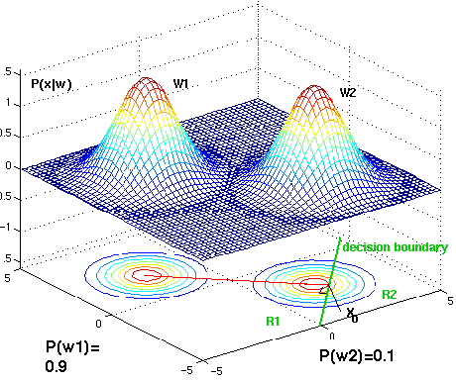
Maximum Likelihood (ML) Classifier
Class C = ω1 or ω2; feature x = (x₁, x₂)
Select class with max P(x|C)
Linear if covariance matrices equal
?
Notes:
Here Gaussians were already fitted to the observed feature samples of each class.
The Maximum Likelihood Classifier assigns the class whose feature probability is largest at the unknown sample. For the point at the question mark, it is Class 1. The probability mass on the wrong side of the boundary is the expected error.
The decision boundary is a linear a (hyperplane) if the class-conditional covariance matrices are equal, otherwise quadratic.
For example, if samples of one class are completely surrounded by samples f another class, the boundary may be spherical or ellipsoidal.

Slide 14
Maximum a Posteriori (MAP) Classifier
Maximum Likelihood (ML) max P(x|C)
Select C with max P(C|x) Bayes formula: P(C|x) = ^{P(x|C) P(C)}
same as ML if priors equal , but priors can ^{P(x)}
make a huge difference when the populations are unequal!
Notes:
The MAP classifier takes into account the prior probabilities of the two classes.
Whether the priors can be estimated from the training data depends on how the raw observations were originally sampled.
We calculate the posterior probabilities from the feature probabilities and the priors using Bayes formula. Here Class 1 is much more probable, so the MAP classifier is biased in its favor.

Slide 15
Bayesian Classifier
Maximum Likelihood (ML) max P(x|C)
Maximum a Posteriori max (MAP) max P(C|x)
same as ML if priors equal
Select C with minimum Risk
(Expected Loss)
Optimal!
same as MAP if λ(i|j) = δ_{ij}
λ(1|2) = $ 1; λ(2|1) = $ 10
Notes:
Misclassifying different classes may incur different costs lambda i,j.
Here mistaking Class 2 for Class 1 is costs ten times more than vice-versa.
The expected cost is called risk.
Unequal costs bias the Bayes Classifier the same way as unequal priors.
(Kronecker delta, NOT Dirac delta)

Slide 16
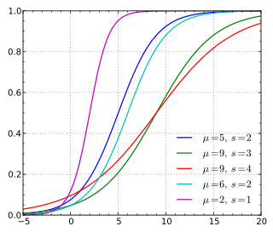
Other probability distributions used in statistical classification
Bernoulli/ Beta Multinomial/Dirichlet (conjugates for 0/1)
Lognormal (for product of independent Gaussian variables)
Chi-square (sum of squares of Gausians)
Logistic for categorical dependent variables
Poisson and Exponential distributions in sequence analysis
(e.g. internet traffic)
Uniform - special case of Beta, mainly for illustrative examples
In nature, uniform distributions are rarer than a hen’s tooth!
Notes:
When the prior probability distribution is the conjugate of the feature distribution, the posterior probabilities will retain the form of the priors.
This facilitates both computation and analysis.
The Beta distribution is the conjugate of Bernoulli, and the Dirichlet of the Multinomial.

Slide 17
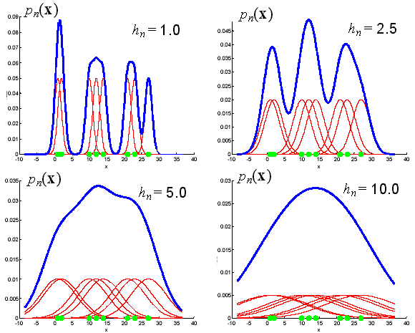
Parzen Widows for estimating
empirical probability density
Notes:
Parzen Windows can approximate any probability distribution of samples.
We place a red kernel at each green sample point that weights nearby points,& add the kernel values.
As you can see, the kernel width h trades off detail versus smoothness of the estimate.
So we should decrease h as the number of samples n increases.
This is a non-parametric estimator. of only theoretical interest, but more about kernels shortly.

Slide 18
Generative vs. Discriminative Training
Generative:
Estimate class-conditional feature probabilities and class priors, then use Bayes formula to calculate posterior probabilities and decision boundaries.
Discriminative:
Estimate
posterior probabilities
or decision boundaries
directly.
Notes:
What I showed you earlier was generative training. Generative models can generate pseudo-samples.
Discriminative classifiers cut to the bait to estimate the posterior probability or decision boundary. They usually have fewer parameters because they neglect irrelevant variations in the feature distributions. Most neural classifiers are discriminative.

Slide 19
Support Vector Machine: 1D → 2D
resists over-training
o + + o x
z
o
o
Kernel-induced transformation
x → v = (y, z) = (x, x²)
+ +
y
with kernel : K(x_{i,}x_{j}) = (x_{i}, x_{i}²)(x_{j}, x_{j}²)^{t} = v_{i}•v_{j}
z
max
margin &
support vectors
o
o
+ +
y
Notes:
Three big ideas here:
1. Transform the samples into a higher dimensional space that preserves distances between samples yet allows linear classification. In this example, in 1-D, the classifier must be quadratic: e.g. choose Plus iff f(x²) < Theta. The boundary in 2-D is linear because we chose a kernel that yields good features.
2. The values of the Kernel for every pair i,j of samples is enough for classification: there is no need to compute the transformed features!
The corresponding (Gram) matrix of the dot-product of every pair i,j of samples may require less storage than the data values themselves.
The kernel can be adapted to the data – that is what Deep Learning does!
3. The red line in the top figure is not the best linear boundary! So find the maximum margin boundary that that is as far as possible from the nearest training samples. This is a quadratic programming problem.

Slide 20
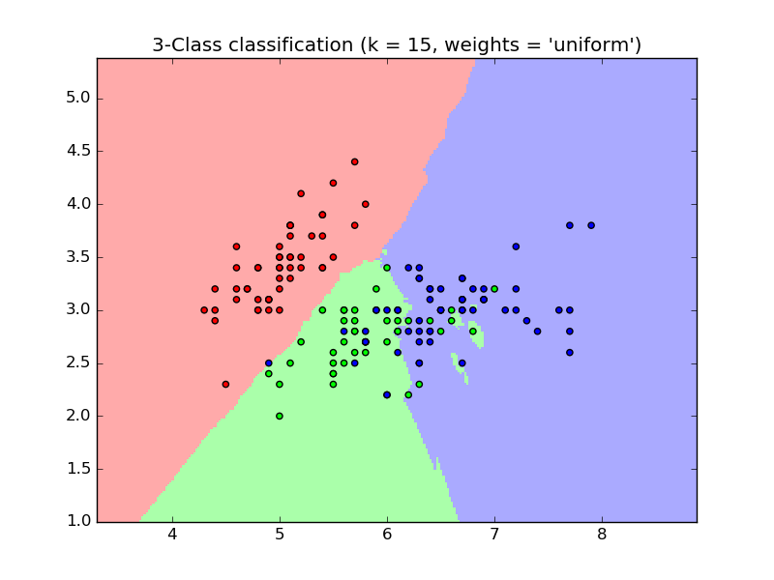
K-nearest neighbors
Effective pruning and speed-up methods are available.
Asymptotic error < 2 x P*
where P* is the Bayes error (error of optimal classifier).
Notes:
Nearest Neighbors is a practical non-parametric version of Parzen Windows.
K, is the number of nearest samples that vote on the label. Here K = 15. Usually it is only 3 or 5, or even just 1.
I always try this is a simple and accurate classifier as a sanity check!

Slide 21
Hidden Markov Models 2 binary features
Input sequence of feature vectors: X = { (0,1), (0,0), (0,1), (1,1) }
X₁
MODEL A MODEL B
1 2 3 1 2 3
Given X, find most probably path given A and given B with Viterbi algorithm
Hidden states
Unfold into a trellis
diagram:
time→
time→
1
P({X}|A)
2
P({X}|B)
3
TRAINING: Estimate joint conditional state feature probabilities
and conditional state transition probabilities
via Baum-Welch Forward-Backward (EM)
Notes:
Each Hidden Markov model generates a feature vector X on every state to-state-transition. For example, a SPOKEN WORD HMM might emit a feature vector of Fourier coefficients 20 times per second.
Training this generative model estimates the feature emission and state transition probabilities.
Then, we can determine the probability of any sequence of input vectors given each trained model, and the most probable state transitions.
The state transitions here are LEFT-TO_RIGHT as often used in speech and handwriting recognition. Training is complicated.

Slide 22
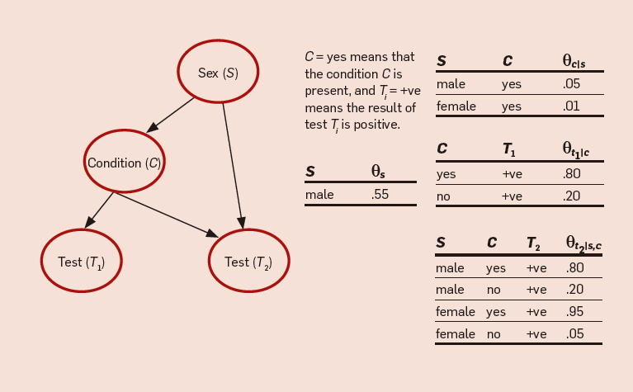
Bayesian Networks (probabilistic graphical models) generalization of Hidden Markov Models using belief propagation algorithms
directed, acyclic graph
Notes:
Bayesian networks represent selected conditional probabilities between features.
This example shows an attempt to predict two test results from gender and some physiological condition.
It is tempting to consider conditional probabilities in graphical models as causal relations.

Slide 23
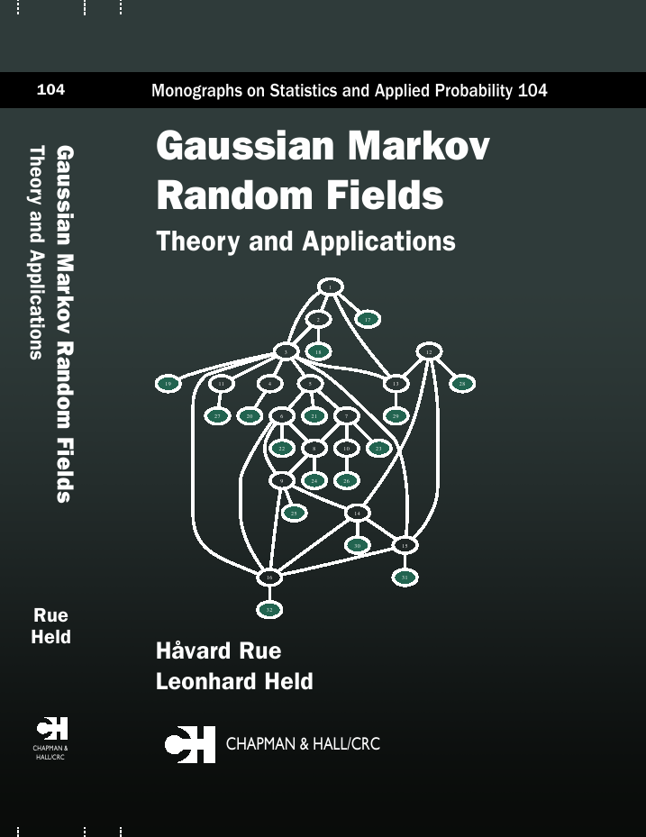
Graphical Models with undirected (possibly cyclic connections)
Notes:
MRFs are used for 2-D input variables like images or printed tables.
The terminology of graphical models is still evolving.
Some consider MRFs generative, and Conditional Random Fields (CRFs) discriminative.

Slide 24
Sampling and Estimation
There are never enough training samples!
BAGGING: re-sampling with replacement to increase
the nominal size of the training set (e.g., when P(ω₁) >> P(ω₂)
BOOTSTRAP PARAMETER ESTIMATE: re-sampling
with replacement to estimate variance of the mean of m samples.
(Better than partitioning)
BOOSTING: reintroducing misclassified training samples into the classifier construction process.
JACKKNIFE: leave-one-out estimate of classifier accuracy
Notes:
Here are some useful notions for estimating parameters from samples.
Suppose that you have m=100 random training samples from one class.
You would like to estimate the variance of its mean (but you have only one mean).
The bootstrap estimate is better that partitioning the 100 samples into, say, 4 groups of 25.
The Jackknife is provides the best estimate of test error with a limited training sample. Train on N-1 samples, test on 1. Then repeat leaving out each sample.
This takes a long time, so let your computer do it while you sleep.

Slide 25
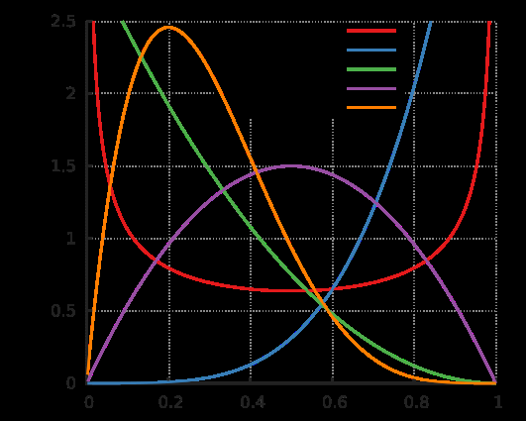
Estimating class-conditional binary feature probabilities
Laplace’s Law of Succession: will the sun rise again tomorrow?
Odds for betting on a biased coin toss:
$\hat{θ}$ = ? after n = 10 tosses when
m = (a) 4 Heads (b) 1 Head (c) 0 Head
$\hat{θ}$ = m/n ML estimate
$\hat{θ}$ = (m+1)/(n+2) if p(θ) uniform on [0,1]
$\hat{θ}$= (m+a)/(n+a+b) if p(θ; a,b) Beta
(priors conjugate, a and b are hyperpriors)
Notes:
This Bayes estimate of binary feature probabilities is useful when there are only a few samples in some class. It is the same problem as estimating the bias of a coin.
Consider betting on tossing a coin that came up Heads once in 10 tosses. You know that this coin was randomly chosen from a bag of coins with bias uniformly distributed on [0,1]. Then the best (Bayesian) estimate is. $\hat{θ}$ = 2/12, not 1/10. Note that the ML estimate for 0 heads is absurd (unless 2-headed…)
U[0,1] is the conjugate Beta distribution with hyper-parameters a=1 and b=1.
However, with the right choice of non-uniform prior distribution, you can get any estimate!
For ordinary coins, the prior is very peaked and centered on 0.5
(so a and b >> 1). Choosing good priors require reliable intuition!

Slide 26
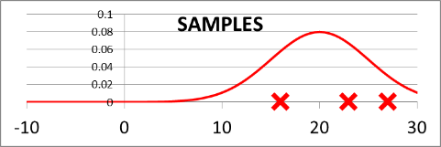
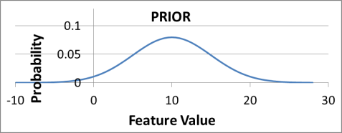
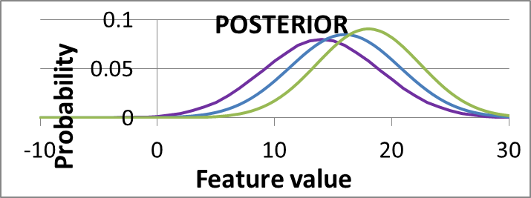
Bayesian Learning of mean of 1-D Gaussian with known variance
Bayesian estimation:
weight given to priors decreases as new samples are added
(Gaussian is self-conjugate)
Notes:
Estimating the mean of a Gaussian distribution follows the same idea.
Our best guess about the mean of the samples is shown in blue. Here the hyperpriors are the mean and variance of the prior distribution of the mean of the sample distribution.
As more samples become available, our estimate moves towards the sample mean.
The weight given to the priors depends on the variance of the prior distribution.
If the variance is small, it will take many samples to move away from it.

Slide 27
Some useful techniques / notions
Green interaction
Clustering: partitioning, fuzzy, hierarchical ….
Expectation Maximization
Distance (and similarity) measures
Classifier combination
Decision trees and tables
Regularization / smoothing
One-shot learning
Dimensionality reduction – principal component analysis
Feature selection
Dynamic programming, Viterbi algorithm
…
Notes:
Let me just define the first item.
Often the output of a classifier is subjected to at least selective inspection and correction.
Green Interaction means that the system should capture and take advantage of every confirmation or correction.

Slide 28
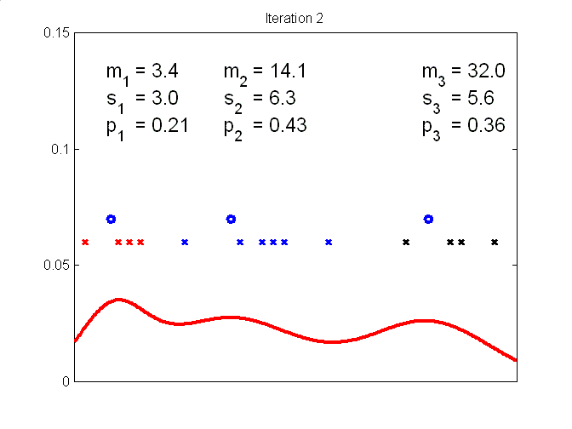
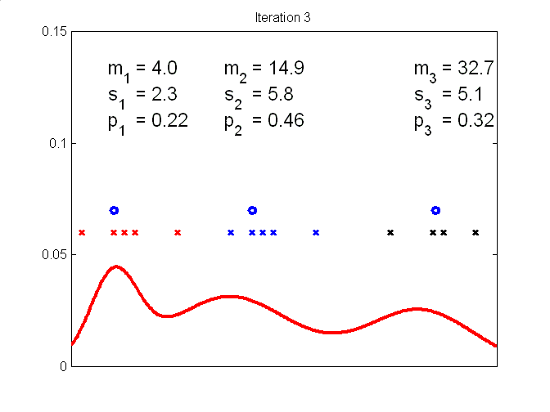
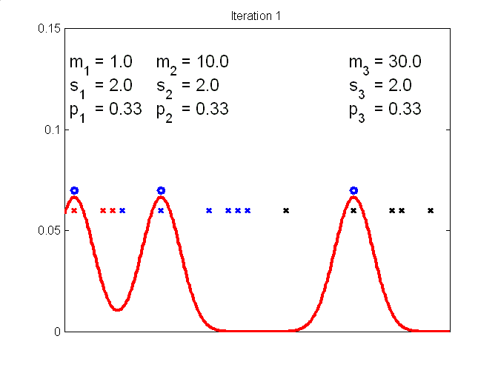
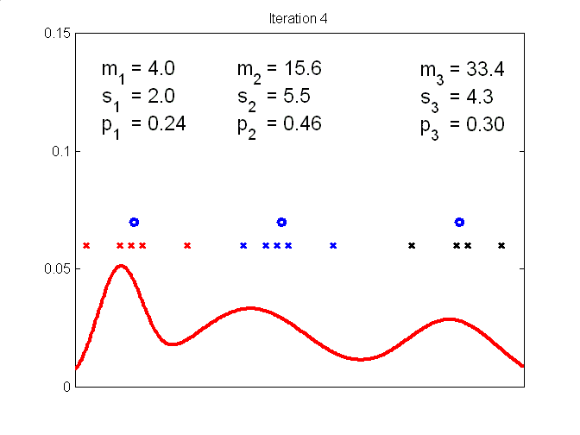
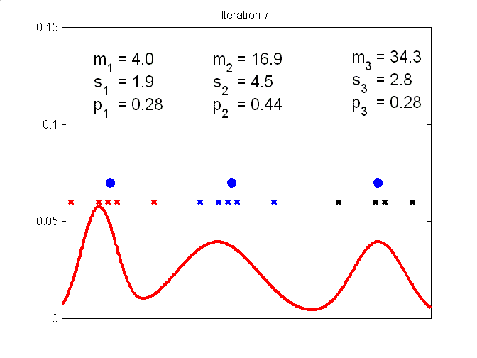
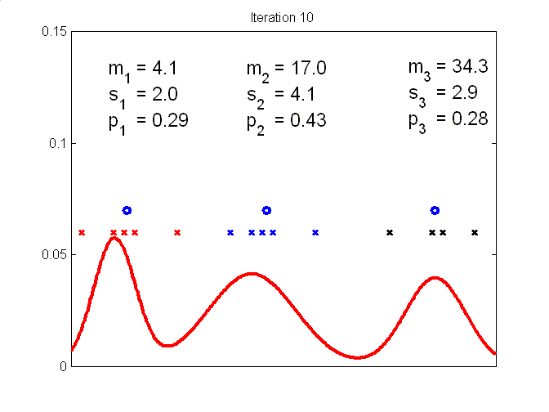
K-means and Expectation Maximization (EM)
Gaussian mixture models
Notes:
K-means is a simple and effective clustering algorithm.
Start with a set of random cluster centers (blue dots)
In Step 1, assign each sample to the closest cluster center (as shown by it color)
In Step 2, recompute each cluster center as the centroid of the samples assigned to it.
Repeat 1. and 2. until there is no further change (which is guaranteed to happen because each step improves the clusters).
Shown are ierations 1-4, 7, and 10.
Expectation Maximization is similar, but based on probability. It is widely used to estimate the mixture coefficients,, means and variances of Gaussian mixtures.
The red line shows its results after each iteration.
Here the EM means are almost the same as the K-means centroids, and the variances are similar

Slide 29
Distance and similarity measures
Metric; non-negative, symmetric, triangle inequality
Pairs of scalars, vectors, images:
Euclidian, Hamming, Tanimoto, Jaccard, Minkowsky, …
76 binary similarity and distance measures listed in a survey!
Edit distance for strings, sequences, trees, graphs :
Levenshtein i/d/s, Wagner-Fischer algorithm
Statistical distance for probability distributions:
Mahalanobis, Kullback–Leibler divergence, Bhattacharyya …
Notes:
Distances play a part in most aspects of classification, including kernel formulation.
There are many pairwise distance functions for vectors, and also for more complicated objects like sequences or high-dimensional probability distributions.

Slide 30
Classifier Combination
Decision optimization:
Combine a set of complete, fully trained classifiers.
Coverage optimization:
Tune each classifier to a different aspect of the training set
(Different subspaces or training samples).
Notes:
Combining full-fledged classifiers seldom yields an error rate much lower than the best classifier,
except possibly for classifiers that accept as input the output of many weak classifiers.
Classifiers can be combined in series, in parallel, or in a hierarchy.

Slide 31
Preprocessing considered harmful
Please don’t
resample,
normalize,
segment,
prune,
deskew,
denoise,
thin, fatten, average, filter
or otherwise “improve” test data!
Instead, measure and save “noise”
or devise invariant features.
Notes:
Campaigning against preprocessing is one of my hobby horses.

Slide 32
TOC
PR & ML
Classification
Neural Networks & Deep Learning
Performance Evaluation
Partially supervised classification
Historical notes on PR & NN
Improved:
Digit recognition
Speech transcription
Face recognition
Image captioning
Probabilistic neural language models
Notes:
Deep networks recently resulted in 20%-30% error reduction on many benchmarks.
But let us start with very shallow networks.

Slide 33
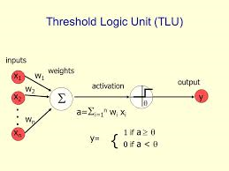
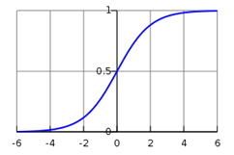
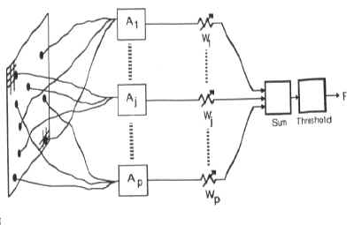
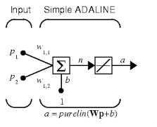
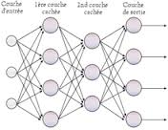
ANNs
Perceptron ADALINE MADALINE
Multilayer Perceptron Deep Convolutional Neural Network
Notes:
Perceptron, Adalines (Adaptive Linear Elements) and Madalines all have a single layer of adaptive weights. For non-linear classification, one or more fixed layers are added before or after the adaptive layer. An activation function is sometimes substituted for a step-function threshold.
Let us see how the weights are adjusted in a threshold logic unit.

Slide 34
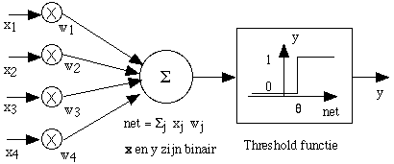
Linear separability in 2-D
TLU
x2
x1
y = 1 iff w⋅x > θ
Weight vector w is perpendicular to separating hyperplane
Notes:
Here we have a network diagram and a graphical representation of its function.
The two inputs are x1 and x2, and a weight vector has elements w1 and w2.
Threshold theta is distance of hyperplane from. the origin.

Slide 35
Equivalent feature space for perceptron training algorithm
solution cone
separating hyperplanes
correction increment
weight vector
current next
Notes:
In this representation it is easier to show how the perceptron training algorithm works.
We get this by adding a unity-valued constant feature to bring the separating hyperplane to the origin and multiplying each object in one class by -1 to flip them to the other side of the hyperplane.
Now every point should be on same side of hyperplane. The circled point is on wrong side of current (dashed) hyperplane.
Correction in direction of misclassified sample moves weight vector towards solution cone.
One more correction will yield the correct boundary.

Slide 36
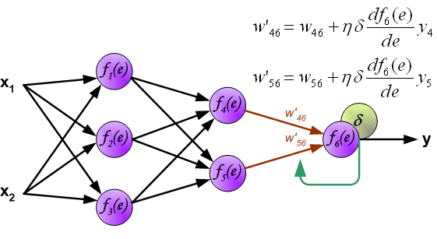
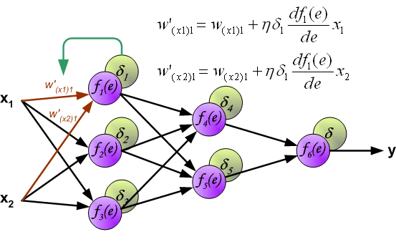
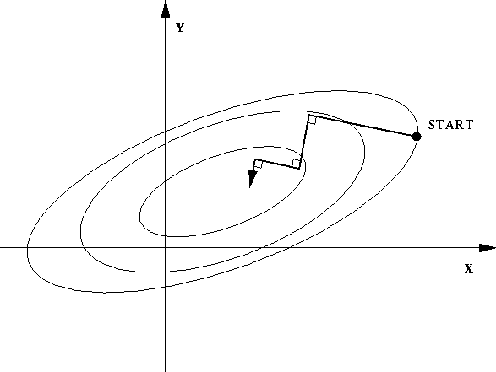
Backpropagation for multilayer network
Backpropagation ≅ gradient descent
Gradient ≅ multidimensional partial derivatives wrt weights
Training: Increase or decrease each weight to improve output
Uses chain rule for derivatives to compute weight changes from output to input.
Stochastic BP ≅ average correction over several samples
Notes:
Backpropagation was invented in 1974 but was dormant for ten years.
It is a gradient descent procedure based on the partial derivatives of the weights in vector space.
It has been recently modified in many ways for deep learning neural networks.
Linear class separability at the output of such networks is a consequence of training to get good weights (features, representation)

Slide 37
Deep Learning with CNN (1)
Advantage: end-to-end - no need for feature design or selection
Convolutional neural networks are based on the Hubel-Wiesel discovery of replicated receptive fields in the visual cortex.
Architecture: 5-20 3-D stacks of 2-D layers
Alternating convolutional and polling layers
Convolution: small receptive fields with shared weights
Increasing abstraction from input to output
Polling: collects similar features from a neighborhood
Enthusiastic review in Nature (May 28, 2015) by LeCun, Bengio & Hinton
Notes:
Convolution here is analogous to convolution in discrete time series.
Polling is usually maximum detection to reduce the locality of the features.
Deep learning is not for the faint of heart.
It requires huge training samples because of the large number of weights to be estimated (even with shared weights in the convolutional layers and decreasing layer size due to polling.)

Slide 38
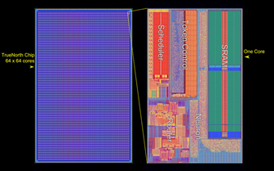
Deep learning with convolutional networks (2)
Layers of increasingly complex representation and decreasing localization
Final 1-D layer is a classifier. Often a complex training regimen,
Pre- and cross-training can reduce training time.
Implementation with GPUs, FPGAs, and neuromorphic chips
New chip:
4096x256x256x1000 = 266 GSops
Notes:
Each plane in a stack computes a different feature (here 32 features on a 40 x 40 pixel image).
Stacks compute features of increasing abstraction towards the output (only 8 final features).
Millions of weights need tens of millions of samples
(e.g., 300 hours of speech with 16,000 samples per second = 0.25 terabytes).
Graphical Programming Units & Field-Programmable Gate Arrays are used to reduce training time.
New IBM chip: 4096 processors, each with 256 neurons with 256 inputs recomputed 1000 times per second yield 266 billion synaptic operations per secon

Slide 39
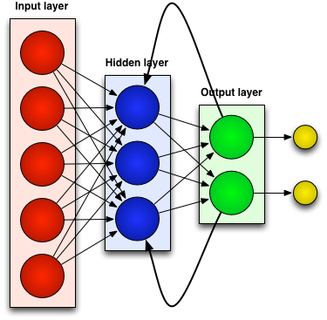
Neural networks for sequences and time series
Recursive NN
Recurrent NN
Hopfield network
Boltzmann Machine
Autocoder
Long short term memory
…
Not yet off-the-shelf tools. Require specialized configuration and training for successful application.
Notes:
Neural networks with cyclic connections and their relation to statistical models are very interesting, but I cannot discuss them with full authority. Let me instead talk a little about what to watch for in classification experiments.

Slide 40
TOC
PR & ML
Classification
Neural Networks & Deep Learning
Performance Evaluation
Adaptive classification
Historical notes on NN & PR
Notes:
Performance is multi-dimensional, but I will focus on error rate instead of run time, computational complexity, stability or replicability.

Slide 41
Data Partitioning
Training – Test (50-50 or 90-10 ?)
Training – Validation 1 – Validation 2 ... Test
Leave-one-out, Leave-P-out (N/P-fold cross-validation)
Non-stationary data?
Sampling with replacement or pseudo-samples?
Examples of alternative training sets:
25,000 samples: 400 sources, 200 samples each
80% training 100 sources, 200 samples each
sample: or 200 sources, 100 samples each
or 400 sources, 50 samples each ?
Notes:
Partitioning the data into training, validation and test set that take into account the source of the samples is critical, Validation sets are necessary for optimizing classifier design. Sources may be speakers, writers, vendors, instruments, craftsmen, lab technicians. – anything that could systematically affect the raw data and hence the features.
In the example here, it was decided to use an 80% training set of 20,000 samples
Training on all 400 sources with 50 samples each will give the lowest error rate.
It is, however, highly unlikely that training samples from all sources will be available for actual operational application, so the resulting prediction will be overly optimistic.
For a better estimate, we could repeat any of these five times with different partitions of the data.
This would be five-fold cross-validation.

Slide 42
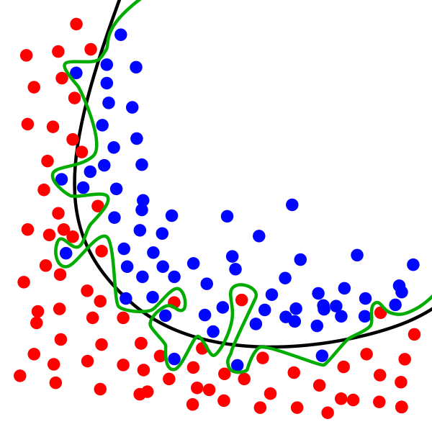
The bias-variance dilemma: over-fitting/ under-fitting
Notes:
The bias-variance dilemma is at the heart of choosing a classifier.
The green boundary is over-fitted, the purple is under-fitted. Both generalize poorly to new data.
We would like to have the black decision boundary.

Slide 43
Training set # 1
Training set # 2
Bayes decision boundary
The bias of the complex classifier is smaller, but its variance is larger.
Any classifier may outperform any other.
Notes:
Boundaries depend on the randomly selected training set.
The green (linear) boundary is generated by a simple classifier with few parameters.
The red boundary is due to a more complex classifier with more parameters.
Bias is constraints on boundary. The complex classifier has less bias
and can therefore better approximate the ideal or Bayes boundary .
With a given number of samples the simpler classifier will give rise to less variability in the boundary.
The bias and variance of both classifiers decrease as the training set gets bigger, but all at different rates.
The classification error (solid lines) is due to both bias and variance. Here the simple classifier is better with fewer training samples, and the complex classifier is better with large training samples
Attributing parts of the error to the bias and the variance is difficult.
So the choice of classifier depends on the number of training samples, the feature dimensionality, the number of classes and the nature of the statistical dependences between vectors. I don’t know any explicit selection formula!

Slide 44
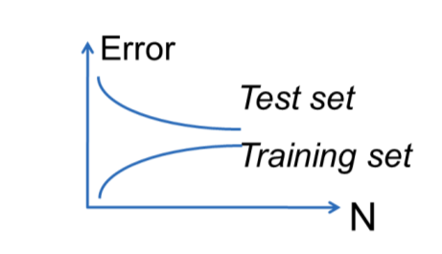
As the size of the training set increases, the training and test error rates of an optimal classifier will eventually converge to the Bayes error. This is zero unless identical patterns can belong to different classes
The Bayes Error
Bayes error
Training set
Optimal classifier Suboptimal classifier
The Bayes Error is the ne plus ultra of theoretical pattern recognition, much like Worst Case Complexity in theoretical computer science.
Notes:
The training and test error rates of an optimal classifier will eventually converge to the Bayes error
However, a suboptimal classifiers may yield increased error on the test set when more training samples cause overfitting.

Slide 45
When is N large enough?
Keep sampling until 100 errors have occurred
for a 95% probability that the true error rate is less than 20% greater than the observed value p.
(Gauss, Chernoff, Guyon, Makhoul, Schwartz, Vapnik PAMI 1990)
Notes:
How large a test set is needed for a good estimate of the test error?
The top formula says that if 100 errors are made on 10,000 samples,
chances are that the true error rate is less than 1.2%.
More samples are required, f course, if the error rate is lower.

Slide 46
McNemar’s test
to compare two classifiers on the same data
n₁ is number of errors made by Classifier 1 but not Classifier 2
n₂ is number of errors made by Classifier 2 but not Classifier 1
(|n₁ – n₂| - 1)²
(n₁ + n₂)
Z² =
The test statistic Z² approximately follows the χ2 distribution with one degree of freedom.
The test value Z² corresponding to 95% confidence is 3.84.
Examples: 10 vs. 20 →fails. 5 vs. 15 →passes.
The overall error rates could be anything!
Notes:
This is a test for comparing two classifiers.
Detailed bookkeeping is required to keep track of the samples misclassified by each classifier. For example, in classification runs on the same test samples,
Classifier A makes ten errors that B got right, and B makes 20 errors that A got right. Then A seems better than B. But we cannot say that with 95% confidence.

Slide 47
Reporting classifier “performance”
Two-class Confusion Matrix:
5 independent values!
Correct + Error + Reject = 1
Recognition Rate (Correct / Total)
Sensitivity & Specificity (Selectivity ?)
Type I &Type II error
False Alarm & Miss
Errors of Omission & Commission
True/False Positive & Negative
(+ is good in war, bad in medicine)
Precision & Recall (F-score/measure)
Reject-error or ROC or Precision/Recall curves
N=100 |  | Classified
True |  | A | B | Reject
 | A | 50 | 3 | 7
 | B | 4 | 30 | 6
Notes:
Even for two classes, there are many ways of reporting classification results.
I prefer a confusion matrix. The other methods give incomplete information.
SELECTIVITY in PHARMACOLOGY
For two-class problems, Receiver Operating Characteristic (true + vs. false +) and Precision/Recall curves are much the same.

Slide 48
Precision-Recall
Operating point
Precision
Recall
Notes:
There is usually a knob on the classifier that can be adjusted to alter the precision/recall ratio. The classifier corresponding to the curve with the largest area under it is considered best. Here B is better than A at very high recall rates.

Slide 49
Training on Test Data
Blatant: e.g. estimating language model from a transcript of the test data or increasing P(q _) after finding 11 occurrences of Iraq in the test data.
Common: Reporting only the best result, e.g. after trying several values of K in K-nearest- neighbors.
Use a validation set. If you make more than one run on the test set, report the maximum error!
Notes:
This is a no-no! Test data must not be recycled.
Consider the two examples.
Most of the statistical felonies that I have seen were in document image analysis. I hope that reporting in biology is more conscienscious.

Slide 50
TOC
PR & ML
Classification
Neural Networks & Deep Learning
Performance Evaluation
Partially supervised classification
Historical notes on NN & PR
Definition:
The label assigned to a sample by an adaptive classifier depends on every sample in the test field.
Notes:
Partially supervised classification is usually adaptive classification
Adaptation?? Q ???

Slide 51
Adaptive algorithms have their own jargon
stochastic approximation (Robbins-Munro algorithm) self-training, self-adaptation, self-correction,
Learning without a teacher, unsupervised / semi-supervised learning, transduction, transfer learning, inductive transfer, co-training, decision/goal-directed learning,
Style constrained/conscious/consistent ...
Notes:
Adaptive classifiers modify their decision boundaries as a function of the test set.
The Ground Truth labels of the test set are still used only to evaluate the final error rate.

Slide 52
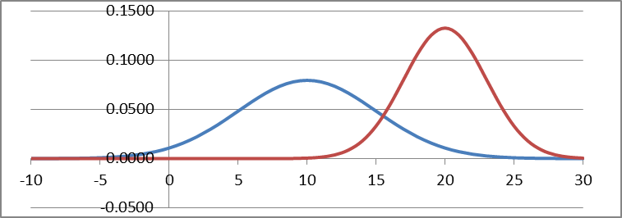
Exponential value of labeled samples
Unlabeled samples from Classes A & B
Parameters of the corresponding Gaussian mixture distribution estimated with Parzen Windows
Gaussian components found via Bayesian Learning and Expectation Maximization, but we don’t know which is A and which is B
A single labeled sample of Class B.
One or a few labeled samples are enough to label the class-conditional probability densities.
Notes:
Suppose we have oodles of unlabeled samples from two classes.
Expectation Maximization can separate the components of a mixture,
but we need at least one labeled sample to label the distributions,
Castelli & Cover

Slide 53
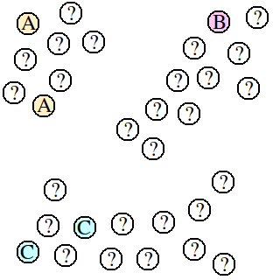
Transductive learning
Makes use of unlabeled samples
Transfer learning:
Classification
Taxonomy
Data compression
Notes:
A classifier designed using only the colored labeled samples would almost surely misclassify the sample at the red arrow.
First clustering all the samples, then labeling the clusters, can avoid this.
Transfer learning makes used of acquired information for diverse tasks.

Slide 54
Unsupervised adaptation
Retrain classifier using assigned labels on each same-source batch
Style 1
Style 3
Style 2
Style 2
Single-style boundary
Style 3
Style 1
←Multi-style boundary→
Notes:
Complicated slide: please bear with me

Slide 55
Inter-pattern feature dependence (1) (Style)
1 or 7 ?
Notes:
An example of style in hand-printed digits

Slide 56
Inter-pattern Feature Dependence (2)
7 11 7 1 7 7 1
The way Ann writes “4” affects how she writes “9”.
Statistical dependence between features of different
isogenous characters.
Notes:
Here is the result of style based classification.
The same pattern is sometimes called “1” and sometimes “7”, depending on the other samples in the field.

Slide 57
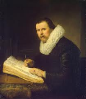
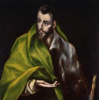
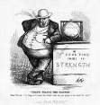
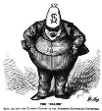
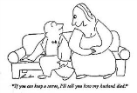
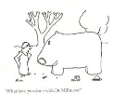
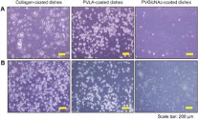
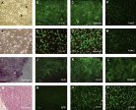
Style due to isogeny is broader than strings of characters!
Paintings
Photos
Cartoons
Micrographs
El Greco, Rembrandt; Irving Penn, Yosuf Karsh; Thomas Nast, Thurber; phase-contrast microscopy;,
Notes:
In scientific data, instrument or and technicians often display their ow signature style

Slide 58
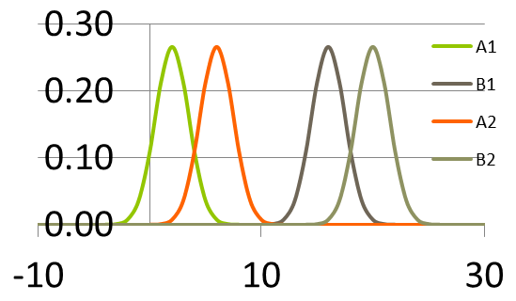
Two classes A & B, two styles 1 & 2, and one Gaussian feature per pattern
Gaussian style classifier (1)
A1 A2 B1 B2
Class and
source conditional
feature probabilities
Feature value
Notes:
The next few slides will show the principle of style-based classification.
There is only a single feature, with value ranging from -10 to 30 on the different patterns.
So there are four overlapping probability distributions for the two classes and the two styles,
Probs larger for Style 2.

Slide 59
Gaussian Styles (2)
pair classifier
AA
AB
BA
BB
AA
AB BA BB
First pattern
Second pattern
x
y
y
Notes:
Either pattern or either class could be the first or second letter any unknown pair, but both must be of the same style. Without this restriction there would be 16 possible pairs instead of 8.

Slide 60
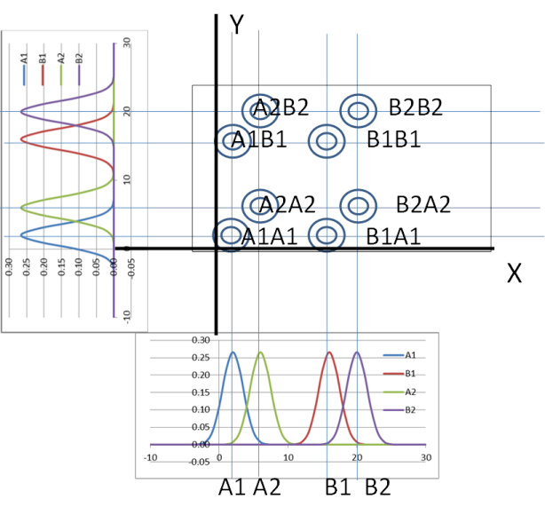
Gaussian Styles (3)
Joint Probabilities of first pattern feature x and second pattern feature y
Notes:
Joint and marginal probabilities of each possible pair.

Slide 61
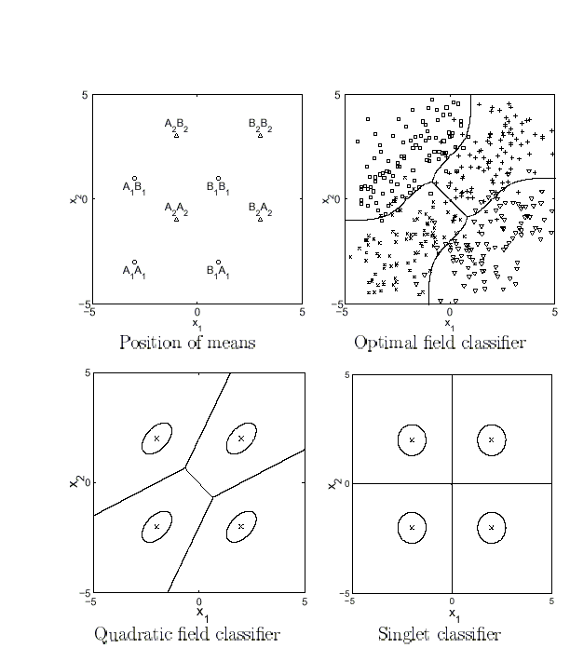
Gaussian Styles (4)
STYLE-CONSCIOUS CLASSIFIERS
Notes:
The optimal boundaries for minimum field error are at the top right.
The classifier at the bottom left is much faster, which would be important with longer fields, more classes, and more features.

Slide 62
How representative is the training set?
training
test
(3) discrete styles
(1) representative
(5) weakly constrained
(2) adaptable (long fields)
(4) continuous styles
(short fields)

Slide 63
Weakly-constrained data
3 classes, 4 multi-class styles
training
test

Slide 64
TOC
PR & ML
Classification
Neural Networks & Deep Learning
Performance Evaluation
Historical notes on NN & PR

Slide 65
Early days of pattern recognition
Data oriented
OCR, Hand print, speech
Blood cells
X-rays
Particle tracks

Slide 66
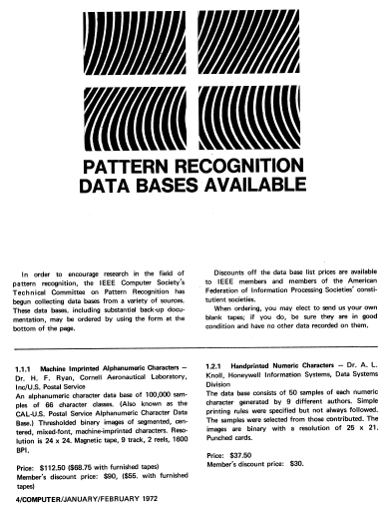
Data Sets advertised in IEEE Computer
January 1972 (6 data sets)
January 1973
April 1976 (10 data sets)

Slide 67
PRC Jan 4, 1973 Disneyland
> 100 attendees at 2-DSP Conf at U. Missouri in August 1972
37 Data Sets purchased!
Machine imprinted alphanumeric characters 1.1.1 7
Handprinted numeric characters 1.2.1 7
Handprinted FORTRAN alphanumeric characters 1.2.2 10
Handprinted alphanumeric characters 1.2.3 7
Handprinted numeric characters 1.2.4 3
Cursive script 1.3.1 3
37
PRC June 7, 1973 NYC
60 Data Sets purchased!
Will be advertised regularly in Computer
Should software (programs) be added?

Slide 68
1962 Ray Bonner: A “Logical Pattern” Recognition Program
27,519 unique 7x10 bitmaps
culled from 1,000,000 samples
2 substitution errors and 14 rejects

Slide 69
Four slides from the NSF-III PI Workshop, April 2010
Director, Information and Intelligent Systems (CISE)

Slide 73
Frank Rosenblatt, my distinguished advisor
MXXVIII – MCMLXX1
Perceptrons
Neurodynamics –
A Theory of Brain Models

Slide 74
Machines
Mark I: 400 S-units,
512 A-units, 8 R-units
Tobermory:
45 band-pass filters
80 difference detectors
80x20 = 1600 A¹ units,
1000 A²-units
12 R-units
12,000 weights between A² and R layers

Slide 75
Marvin Minsky (1927 - )
In 1951 he built the SNARC, the first neural network simulator.
2008
Symbolic vs. Connectionist 1990:
Why is there so much excitement about Neural Networks today, and how is this related to research on Artificial Intelligence? Much has been said, in the popular press, as though these were conflicting activities. This seems exceedingly strange to me, because both are parts of the very same enterprise. What caused this misconception?

Slide 76
Conclusion Remarks
A bewildering variety of tools are available for “big” data analysis, including fast and reliable software in the Matlab, Mathematica and Python communities.
Theoretical predictive properties of classifiers are largely based on assumptions invalid in practical applications. All statistical independence assumptions are suspect.
Any classifier may be best on some data.
As with other specialized fields, evolving vocabulary can be a real entrance barrier.
Notes:
Lots of excellent code is available in the various programming language communities.
We don’t yet have good enough theory to predict error rates on most data of interest.
The interdisciplinary nature of PR and ML promotes confusing verbiage.

Slide 77
Thank you!
WORD POWER
ML; MAP; Bayes (error, estimate, learning); Conjugate PDFs;
Generative/Distributive training; Bias/Variance dilemma;
Feature space; Class-conditional statistical dependence;
Separating hyperplane; Kernel; Gram matrix;
KNN; K-means; EM; SVM; HMM; MRF, CRF; TLU;
Bagging; Bootstrap; Jackknife; Validation set;
Perceptron algorithm; Back-propagation; Deep Learning;
Convolutional Neural Network; Green interaction;
Notes:
My apologies to the Readers Digest. I hope that some familiarity with the jargon will help you to find use for pattern recognition and machine learning in your research! THANK YOU.

Slide 78
TEXT PRINTED WITH SPITZ GLYPHS

Slide 79
DECODED TEXT
chapter i _ bee_inds
_all me ishmaels some years ago__never mind how long precisely __having little or no money in my purses and nothing particular to interest me on shores i thought i would sail about a little and see the watery part of the worlds it is a way i have ...
chapter I 2 LOOMINGS
Call me Ishmael. Some years ago – never mind
how long precisely – having little or no money in
my purse, and nothing particular to interest me on
shore, I thought I would sail about a little and see
the watery part of the world. It is a way I have ...

Slide 80
STOCHASTIC DISCRIMINATION [Eugene Kleinberg ‘00]
Duality between sample space of weak models and feature space
The Central Limit Theorem
Enrichment: each of many weak “models” must favor some class;
Uniform coverage of populated region;
Characteristics of the sample space of weak models with respect to any point same whether that point is a training point or a test point.

Slide 81
My email:
nagy@ecse.rpi.edu
My homepage:
https://www.ecse.rpi.edu/~nagy/

Slide 82
Static Singleton Classifiers: Bayes: Single & Multimodal, Linear, Quadratic, Gaussian and Bilevel [DHS 01] Neural Networks: Backprop, LVQ, RBF, [BC 95] Support Vector Machine [VV 98] Nearest Neighbors [DHS 01] Decision Trees and Decision Forests [TH 98]
Classifer training: Dimensionality and sample size [RJ 91, LSF 01]] Bias and variance [GBD 92], Bagging, Boosting, Random Subspaces [JDM 00] Clustering & Expectation Maximization [TK 99, DLR 77, RW 84] Generalization, Validation, and Error Prediction: Validation, Jackknife, Bootstrap [DHS 01], [JDM 00]

