Slide 1
Student – Advisor Meeting
CLASS of 2013
SPRING 2011
Advisor: Dr. Agung Julius

Slide 2
Topics to be covered
SAM requirement
Meetings schedule
Registration for FALL 2011
Curriculum templates and prerequisite trees
Frequently Asked Questions
Additional Resources
These slides can be downloaded from my advising website:
www.ecse.rpi.edu/~agung/advising.htm

Slide 3
Student & Advisor Meeting (SAM)
Motion passed by Faculty Senate March 2006
“The office of the Provost, working with the Registrar and Division of the Chief Information Officer should institute a system by which all students are obligated to meet with their academic advisors at least once per year. A system of checks needs to be put in place so that both advisor and student verify the meeting occurred before the student can register for classes.”
Please remember to sign the attendance list!

Slide 4
Meetings in this Semester
General Meeting (this meeting)
Individual sessions
Schedule: Wednesday 3/23, Thursday 3/24, Tuesday 3/29
Sign-up in advance at the doodle page (see my email)
Anybody can sign-up
Bring curriculum templates and pre-requisite trees
Office hours: Monday, Wednesday 4-5pm.
Office: JEC 6044
Email: agung@ecse.rpi.edu

Slide 5
Registration for FALL 2011
Which courses to take?
Factors that you should consider in deciding your course composition:
Various degree requirements
Prerequisite tree/ Course dependence
Your capability
What/who to consult:
Course Catalog (http://catalog.rpi.edu)
CAPP report (from SIS)
Academic advisor

Slide 6
Registration for FALL 2011
Which courses to take?
Factors that you should consider in deciding your course composition:
Various degree requirements
Prerequisite tree/ Course dependence
Your capability
What/who to consult:
Course Catalog (http://catalog.rpi.edu)
CAPP report (from SIS)
Academic advisor

Slide 7
Various degree requirements
Where to find them: CAPP report, curriculum templates.
Some requirements that I would like to discuss:
Professional Development
Communication Intensive Courses
Humanities and Social Sciences
Required Electives

Slide 8
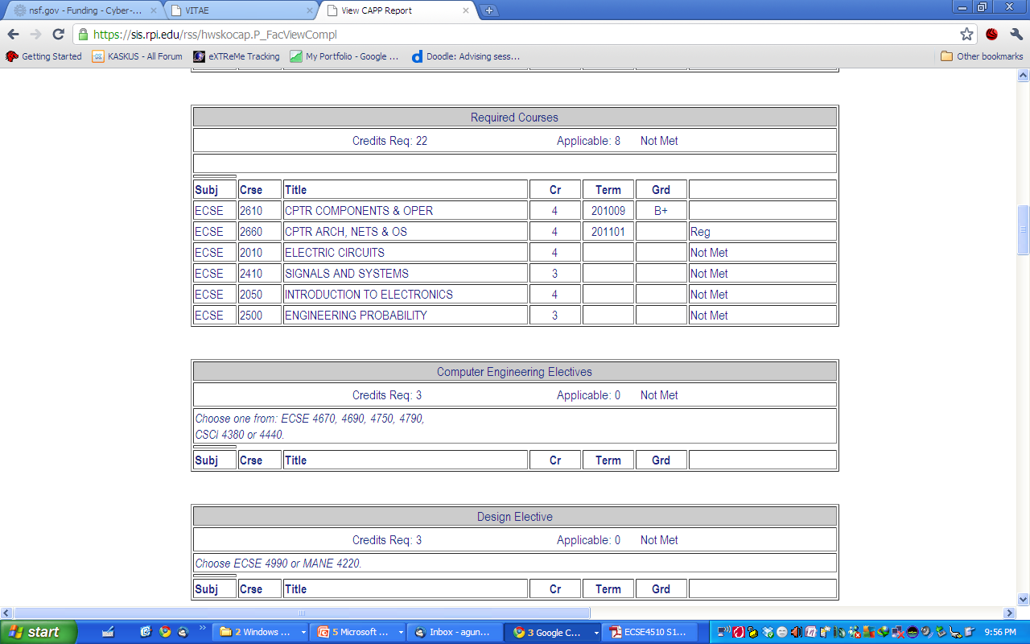
CAPP Report

Slide 10
Communication Intensive Requirement
Students must meet this requirement before they can graduate from Rensselaer.
Students will need to take a course in their major and in HASS.
Most capstone design courses are “CI” courses for the major and HASS are diverse.
Entire List of courses are on SIS front page

Slide 13
Guidelines for Humanities, Arts & Social Sciences (HASS)
24 Credits are required for HASS -6 classes
Need to take a minimum of 2 courses from both the Humanities and Social Sciences ( 8 credits each)
Can only have 3-1000 level classes
Need to complete a depth sequence (examples: 1000 writ & 2000 writ ;2000 Phil & 4000 Phil;
Need to have a 4000 level course.

Slide 14
Understanding Humanities, Arts & Social Sciences Breakdown
Humanities | Social Science
Art (ARTS) | Anthropology (STSS)
Literature( LITR) | Psychology (PSYC)
Music (ARTS) | Economics (ECON)
Communication (COMM) | Sociology (STSS)
Writing (WRIT)
Philosophy (PHIL)
Science Technology Studies (STSH) History (STSH)
* Interdisciplinary Studies-IHSS
can be used as a Humanities or Social Sciences course

Slide 15
Other rules
No more than six credits can be taken as Pass/No Credit
IHSS Courses will be in a free elective section on the student’s CAPP Report
Students can go to the Registrar’s Office & request the course to be changed to either Humanities or Social Sciences
Students can only transfer in or receive AP credit for 8 credits within your HASS core requirements.
Further inquiry: Ms. Elizabeth Large (largee@rpi.edu)

Slide 16
Required Electives (an oxymoron?)
These are courses that you HAVE TO take (thus, required). However, you can choose from a list of options (hence, elective)
You can find them at the bottom of your curriculum template, or in your CAPP report.
Concentration electives are not listed in the curriculum templates. Consult the following website for the list of concentration electives:
www.ecse.rpi.edu/senior_advising_cse_ee_techcon.html

Slide 17
Curriculum Templates and Pre-requisite Trees
Six popular major combinations: ELEC, CSYS, ELEC/CSYS, CSYS/CSCI, ELEC/PHYS, ELEC/BMED.
Note: Electrical Energy Systems is ECSE-2110
Dual major means you have to satisfy the graduation requirements of both majors.
Info on dual major/minor/double degree can be found in the slides from 3rd advising meeting. (See downloadables at my advising website).
Consult the template when registering for a new semester. Plan ahead.
The templates are suggested course line-up. There is some flexibility, especially if you are single majored.

Slide 18
Pre- and Corequisite Courses
Prerequisite: the course(s) that must be completed before taking the current course. Example: MATH-2400 is a prerequisite for ECSE-2010, i.e. you need to have passed Diff. Eqs. before taking Electric Circuits.
Corequisite: the course(s) that must be completed before OR being taken while taking the current course. Example: MATH-1020 is a corequisite for PHYS-1220, i.e. you can take Calculus II and Physics II at the same time, but you cannot take Physics II before Calculus II.
Where to find this information: Course Catalog (catalog.rpi.edu)
Warning: The pre-/corequisite chains can be long. Plan ahead.

Slide 19
Electrical Engineering Program – Co/Prerequisite Tree
Class of 2013
CHEM-1100
F
MATH-1010
F/S
PHYS-1100
F/S
ENGR-1100
F/S/Su
ENGR-1200
F/S/Su
CSCI-1100
F/S
MATH-2010
F/S
MATH-1020
F/S
PHYS-1200
F/S
ENGR-2050
F/S/Su
ENGR-2350
F/S/Su
MATH-2400
F/S
ECSE-2010
F/S/Su
ECSE-2610
F/S/Su
ECSE-2050
F/S/Su
ECSE-2100
F/S/Su
ECSE-2110
S
ECSE-2410
F/S/Su
ECSE-2210
F/S
ECSE-2500
F/S
: prerequisite
: corequisite
F : Fall semester
S : Spring semester
Su: Summer semester
Note: Required elective courses are not shown here. Find out from the Catalog and continue your tree.

Slide 20
Computer and Systems Engineering Program – Co/Prerequisite Tree
Class of 2013
ENGR-2350
F/S/Su
CSCI-1100
F/S
MATH-1010
F/S
PHYS-1100
F/S
ENGR-1100
F/S/Su
ENGR-1200
F/S/Su
MATH-2800
S
MATH-1020
F/S
PHYS-1200
F/S
ENGR-2050
F/S/Su
CSCI-1200
F/S
MATH-2400
F/S
ECSE-2010
F/S/Su
CHEM-1100
F
ECSE-2610
F/S/Su
CSCI-2300
F/S
ECSE-2050
F/S/Su
ECSE-2410
F/S/Su
ECSE-2500
F/S
ECSE-2660
S
MATH-2010
F/S
: prerequisite
: corequisite
F : Fall semester
S : Spring semester
Su: Summer semester
Note: Required elective courses are not shown here. Find out from the Catalog and continue your tree.

Slide 21
Computer and Systems Engineering Program – Co/Prerequisite Tree
Class of 2013
ENGR-2350
F/S/Su
CSCI-1100
F/S
MATH-1010
F/S
PHYS-1100
F/S
ENGR-1100
F/S/Su
ENGR-1200
F/S/Su
MATH-2800
S
MATH-1020
F/S
PHYS-1200
F/S
ENGR-2050
F/S/Su
CSCI-1200
F/S
MATH-2400
F/S
ECSE-2010
F/S/Su
CHEM-1100
F
ECSE-2610
F/S/Su
CSCI-2300
F/S
ECSE-2050
F/S/Su
ECSE-2410
F/S/Su
ECSE-2500
F/S
ECSE-2660
S
MATH-2010
F/S
EXAMPLE
John Q. Student
: prerequisite
: corequisite
F : Fall semester
S : Spring semester
Su: Summer semester
Note: Required elective courses are not shown here. Find out from the Catalog and continue your tree.

Slide 22
What you need to do
Download these slides
Get your prerequisite tree
Continue the tree with your choice of electives
Plan accordingly
You may change your mind re: choice of electives later. However, it’s always better to consult the tree.
If your tree is not available, build one using the template and the course catalog.

Slide 23
Frequently Asked Questions
How do I transfer credit from other institutions?
Always consult before you take any course outside. The course needs to be approved by RPI based on the course description and syllabus. Example:
HASS courses: consult Ms. Elizabeth Large (largee@rpi.edu)
ECSE courses: consult Prof. Gary Saulnier (saulng@rpi.edu)
Are there tutorial sessions for 2xxx level courses, outside of TA and Instructor office hours?
There can be. ALAC offers tutorial sessions on case-by-case basis. Check with ALAC at SAGE 2106 and fill out request form.

Slide 24
Frequently Asked Questions
I need to get into a section/class that is full. What can I do?
Option 1: Request instructor’s approval to register. There is a form for this.
Option 2 (if available): Sign up for a waiting list.
In either case, you need to visit the School Engineering Office at JEC 3018.

Slide 25
Coop and Internship
Provide opportunities for gaining work experience and financial support.
Improve job opportunities after graduation.
There’s full-time and part-time coop.
Only after completing freshman year.
More info: http://www.rpi.edu/dept/cdc/students/experience/coop/index.html

Slide 26
Job Opportunities
Work Study is organized by the Financial Aid Office (2000 Level, Academy Hall)
http://admissions.rpi.edu/aid/current_students.html
Check job opportunities with Career Development Center (CDC), including internship.
http://www.rpi.edu/dept/cdc/

Slide 27
Undergraduate Research
Work with a faculty member on a research project and get:
Academic credit
Paid
Experience
Where to find more information:
http://undergrad.rpi.edu

Slide 28
International Programs for Students
Rensselaer Engineering Education Across Cultural Horizons
Starting in Spring 2009 for Class of 2010
Denmark Technical University
Nanyang Technical University, Singapore
Other partnerships under development
Global Engineering Education Exchange Program
Individual educational opportunities at multiple universities worldwide
Campus wide programs through the Vice Provost’s Office
http://undergrad.rpi.edu/update.do?catcenterkey=81

Slide 29
Q & A
Any question?

